Slide 1
Access ALAYA = A Multiuser Framework for MS-Access =
Accessによるマルチユーザ環境のフレームワーク
始め方解説資料
© 2022 abete21
https://accessalaya.jp
AccessALAYA@gmail.com

Slide 2
What is Access ALAYA？
Access ALAYA is a framework designed to support the development and operation of applications built with Microsoft Access.
In many departments and small teams, it is common to share data such as ledgers, logs, and management records. Microsoft Access is particularly effective in small-scale environments where setting up a full database server is unnecessary, offering the convenience of Excel with the structure of a relational database.
However, while multi-user operation is fundamental to database systems—allowing users to update data at the moment it is generated—Access was originally designed for standalone or very small groups of two or three users. As a result, when used in a multi-user environment with default settings, Access databases can easily become corrupted due to inherent vulnerabilities.
Access ALAYA eliminates these weaknesses and enables stable multi-user operation for groups of several dozen users.
By developing systems on top of ALAYA, teams within a department can safely share and operate ledgers and other data with confidence.
Although Access is a user-friendly platform, building a complete system from scratch can be challenging. With the ALAYA framework, the essential components are already in place. Developers can simply extend the system by adding user features using ALAYA’s templates and libraries, making it much easier to build robust applications.
Access ALAYA provides an efficient environment for application development and customization.
The name “ALAYA” comes from the Sanskrit word meaning “storehouse” or “repository”. For example, “Himalaya” originates from “Hima” (snow) + “Alaya” (a place where snow accumulates). In Buddhism, ālaya-vijñāna is translated as the “storehouse consciousness.”
Access ALAYA aims to bring together office data that has traditionally been scattered across multiple files and locations, allowing it to be centrally managed—just like a storehouse.

Slide 3




Features Of Access ALAYA
1. Multi-User Support
ALAYA is designed from the ground up for multi‑user database operation.
Microsoft Access assumes single‑user or very small‑team usage. When used by multiple users with default settings, Access databases are prone to corruption due to inherent architectural limitations.
Access ALAYA avoids these vulnerabilities and enables safe, stable operation for groups of several dozen users.
In fact, systems built with ALAYA have been used by groups of around 100 users for nearly a year without any maintenance and without issues. This scale is more than sufficient for departmental or team‑level operations.
ALAYA also remains stable even in slow or unstable network environments, such as VPN connections. In the author’s environment, a first‑generation Raspberry Pi (not Pi3 or Pi4) is used as a VPN server for remote operation. Although extremely slow, the system still functions reliably.
In short, ALAYA eliminates Access’s multi‑user weaknesses and enables safe data sharing for groups of several dozen users.
File Server
数十人規模：
部内や課内など少人数の運用では十分なユーザ数
Shared Tables

Slide 4
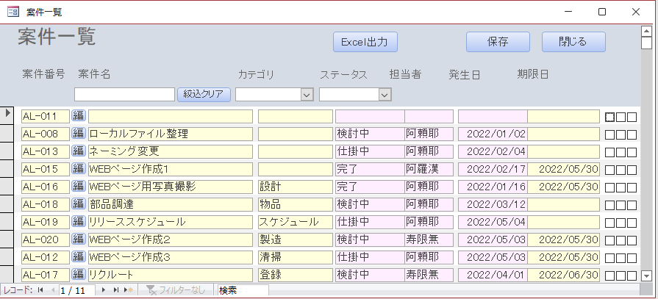
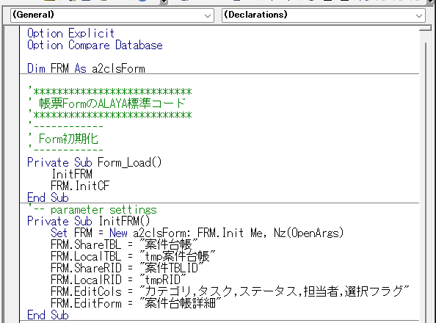
2. Low-Code Development
Using ALAYA’s built‑in functions enables low‑code development. For example, in a standard form, simply calling the initialization function provides the following features:
1. Color‑coding of editable and non‑editable cells
2. Color‑coding of updated and deleted rows
3. Record filtering
4. Screen‑flow control (Save, Close, Export to Excel, etc.)
5. Saving updated or newly added records
Because developers can focus on business logic rather than boilerplate code, code readability improves and maintainability increases.
Screen-flaw control
Record filtering
Saving updates
Color-coding of editable/non-editable cells.
Required Code.

Slide 5


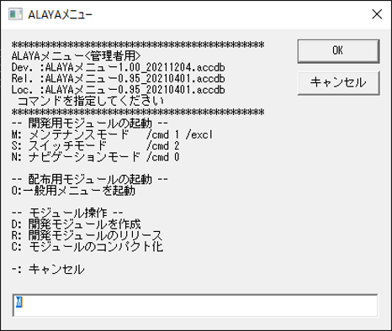
3. Versioning and Development Management
Adding new features to user modules is essential.
ALAYA assumes frequent version updates typical of RAD (Rapid Application Development). Therefore, it provides mechanisms for:
Module updates
Version management
Automatic distribution of updated modules to clients
This ensures smooth deployment and consistent operation across all users.
File Server
\\Server\AccessALAYA
Script（Short cut)
\ALAYADB
ALAYA_Startup.vbs
\ALAYAMenu
\ALAYAScript
\DBBackup
Clients
Administrator’s Menu.

Slide 6
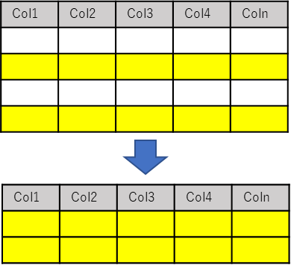
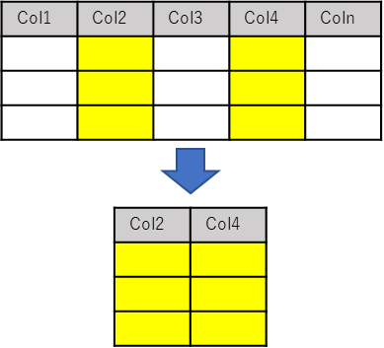
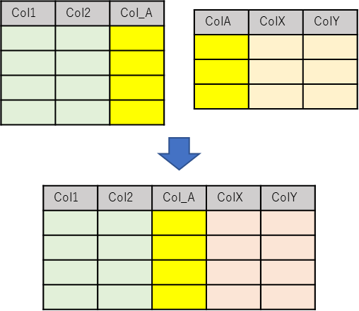

4. A theory-Based System
Access ALAYA is built on first‑order predicate logic and relational algebra.
Predicate logic was introduced by Frege in the mid‑19th century, and relational algebra was presented by E. F. Codd in the late 20th century as a theoretical foundation for relational databases. These are classical theories that form the basis of modern relational database systems.
Some argue that practical system development should prioritize real‑world constraints over theory. Many developers believe that database normalization is an idealistic concept and that denormalization is the norm in real implementations.
However, there is a vast difference between:
Intentionally relaxing normalization with full understanding of the theory, and
Ignoring the theory from the beginning and building a denormalized structure.
System development should not rely solely on intuition or experience; it should be grounded in sound theoretical principles.
Access ALAYA places great importance on these foundational theories. Just as a building with a strong foundation withstands earthquakes and storms, a system built on solid theoretical principles is robust and adaptable to environmental changes and evolving business requirements.
∀x∈P,{∃x∀y∈P｜x∈N, y∈N ,y<x/2, Mod(x,y)=0}
⇒ x∈P,y∈P

Slide 7
Install and Environment settings

Slide 8


Access ALAYA standard Modules
\AccessALAYA.zip
ALAYA standard modules
\AccessALAYA
\ALAYAMenu
ALAYA Menu 2.03.accdb
ALAYAメニュー起動.vbs
ALAYAメニュー.def
\ALAYADB
\ALAYA Installer
Installer is here !
\Starting AccessALAYA
ALAYA Menu**.accdb
This is the GUI module that provides the user interface.
The module with the highest version number is treated as the development module, while the version specified in the release definition file is the distribution module. During version upgrades, the release definition file is updated by script, a new version number is assigned, and the development module is copied accordingly.
Start ALAYA.vbs
This is the startup script for launching the GUI module.
It is executed on client machines to automatically distribute updated modules and to open the administrator menu. A shortcut to this script should be distributed to all client users.
ALAYA Menu.rel
This is the release definition file. It is a simple text file that contains the name of the menu module designated for distribution. The startup script references this file to determine which version of the menu module should be launched.
AlayaDB
This contains sample shared tables.
During installation, this database is copied to the file server.
Alaya Installer
This folder contains the installer used to deploy the ALAYA modules onto the file server.
Starting ALAYA
This is the folder that contains the document you are currently reading.

Slide 9
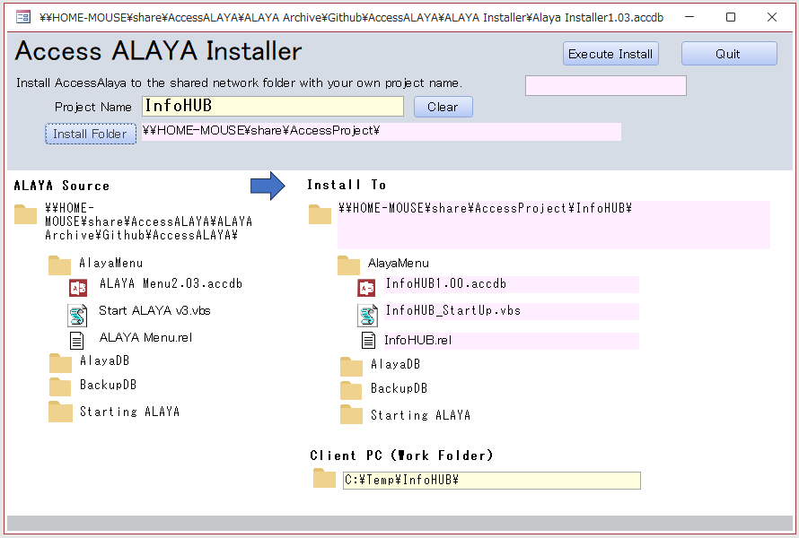
Installation
The installer is located in the “ALAYA Installer” folder. Launch the installer with the highest version number, as that is the latest release.
When you start the installer, the following configuration menu will appear. You need to configure three items:
ProjectName
The name of the project to be installed. Choose a name that is easy for your team or group to recognize.
Install Folder
Specify the network folder where ALAYA will be installed. If you are not using ALAYA in a group and only need it for personal use, you may specify a local drive instead.
Client PC(Work Folder)
Specify a local folder used for client‑side module operations. When the startup script is executed, the distribution module will be copied here and launched automatically.
After configuring these three items, click Install. The required modules will be copied to the designated locations.
Uninstallation
ALAYA does not modify the Windows registry. To uninstall, simply delete the contents of the installation folder. This completes the uninstallation process.

Slide 10
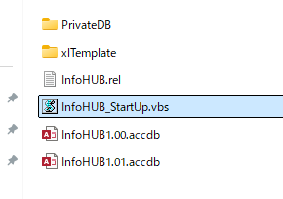
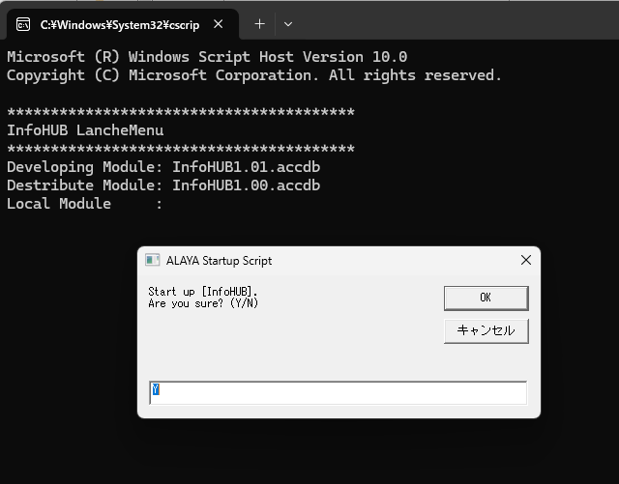
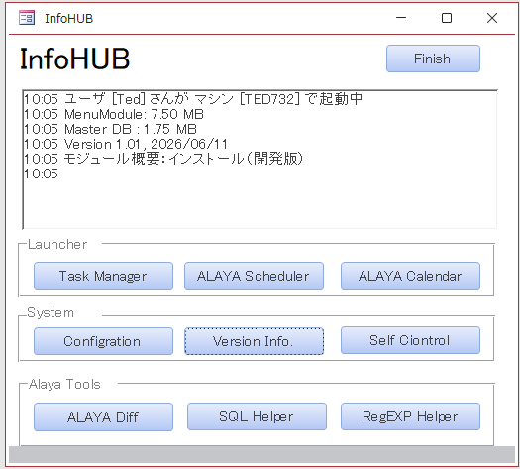
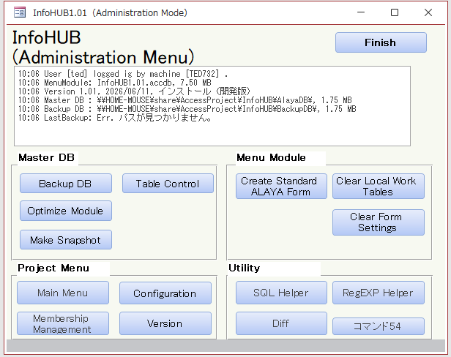
Startup Test
Inside the installation folder, the GUI module will be copied into “AlayaMenu”. Run the startup script. If both Normal Mode and Admin Mode launch successfully, the installation is complete.
At the startup dialog:
Press Enter -> Normal Mode
Type “ad” and press Enter -> Admin Mode
[ProjectName]_Startup.vbs
Press Enter → Normmalmode
‘ad’+ Enter → Admin mode

Slide 11
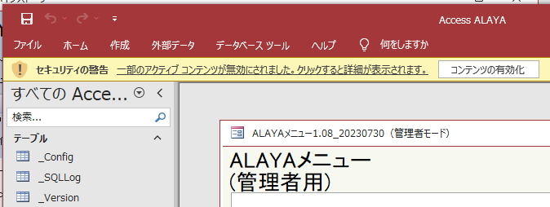
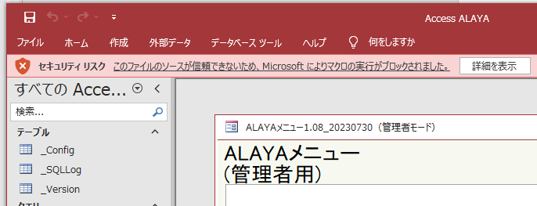
Tips
When running a downloaded module for the first time, Windows may display a Security Warning. In this case, click “Enable Content” to allow execution. After enabling it once, the warning will not appear again.
You may also encounter a Security Risk message that blocks execution. If this happens, either:
Unblock the module in its file properties, or
Add the installation network folder to Trusted Locations in Access.
This will allow the module to run normally.
インターネットからのマクロはOfficeでは規定でブロックされます

Slide 12
Alaya startup script overview.
The ALAYA startup script ([ProjectName]_Startup.vbs) is a plain text file and can be edited freely. The code is not complex, so you should be able to understand its behavior by reading it.
Below is an explanation of the script variables and internal functions for reference.
Script Variables.
ModuleName | The name of the GUI module used by end users. This is typically set to the Project Name.
ReleaseDef | The name of the release definition file. The default format is usually: ProjectName.def —but any filename is acceptable.
LoclFolder | The local working folder on the client PC. The distribution module is copied from the network folder into this location and launched from here.
MenuFolder | The folder where the GUI module is stored. Specify the folder that contains the module referenced by ModuleName. By default, this is the folder where the script itself resides. If you distribute the script directly to clients (instead of distributing a shortcut), specify an absolute path.
DBGFLG | When set to True, the script outputs trace information. Enable this option if the script is not working correctly and you need to debug its behavior.
Script function.
内部関数 | 機能
RunNormalMenu | Run the Main module in normal mode.
RunAdminMenu | Run the main module in Administrator’s mode.
GetDevModule | Return the name of the development module.
GelRelModule | Return the name of the distribution module.
GetLocModule | Return the name of the local module in the client PC.
CreateDevModule | Create a new development module by copying the latest module.
ReleaseDevModule | Release the development module as the distribution module.
OptimiseModule | Optimise and compress the specified module.
DBOptimise | Optimise and compress the .accdb module.
Note: Planned Migration of the Startup Script
Microsoft has announced that VBScript will be phased out in the future. For this reason, the current startup script—implemented in VBScript—is planned to be replaced with PowerShell or another modern scripting environment at a later stage.

Slide 13
Shared Table and Generating Forms.

Slide 14
Shared Tables and How ALAYA Works
Microsoft Access allows shared tables to be used as linked tables, enabling users to read and update server‑side data from their local environment. However, Access’s shared‑lock mechanism is extremely fragile. When multiple clients write directly to linked tables using default settings, the database can be easily corrupted.
ALAYA avoids this vulnerability using a very simple and robust operating principle:
1. Copy shared table data into a local table.
2. All record additions and edits are performed on the local table.
3. When the user clicks the Save button, only the differences are written back to the shared table.
With this approach:
The shared table is never kept open during editing.
Access occurs only once at load time and once at save time.
This ensures safe updates and significantly improves performance.
All interactions with the shared table are performed using SQL statements. DAO/ADO‑based writes tend to be unstable and prone to corruption, whereas SQL‑based writes use proper locking mechanisms and remain stable even in multi‑user environments.
Because ALAYA accesses linked tables only minimally, performance remains excellent—even when using:
ODBC connections to external databases
SharePoint‑hosted tables
Link Tables direct
Access default mechanism.
Keep link tables open during editing. This action easily cause corruptions.
Shared Tables
Copy of the data
（Local Table）
Accessa ALAYA Works
Access occurs only once at load time and once at save time.
All interactions with the shared table are performed using SQL statements.
Shared Tables

Slide 15
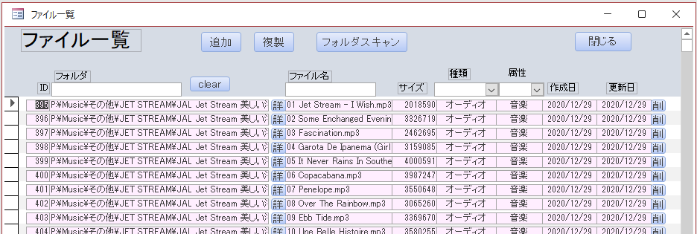
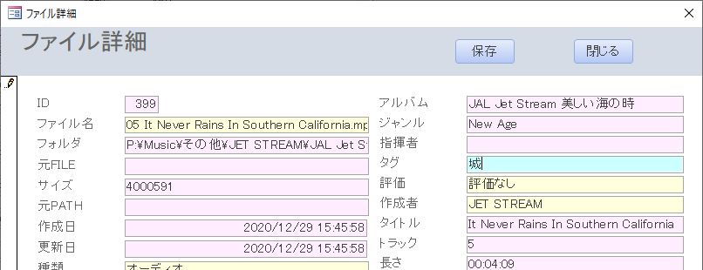
Form Types: Continuous Forms and Single Forms
In Access, data input/output interfaces are created using Forms. There are two primary types:
Continuous Form (帳票Form)
Displays and edits records in a list view.
Single Form (単票Form)
Displays and edits one record at a time.
A common workflow is:
Use a Continuous Form to browse and select a record.
Open a Single Form to view or edit detailed information.
If the number of fields is small, a Continuous Form alone may be sufficient.
Using the Form Generation feature (described later), Access ALAYA can automatically generate standard forms with default controls and embedded code.
Continuous Form:
Displays and edits records in a list view.
Table
SingleForm:
Displays and edits one record at a time

Slide 16
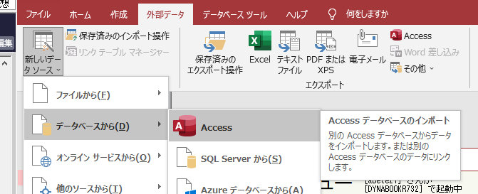
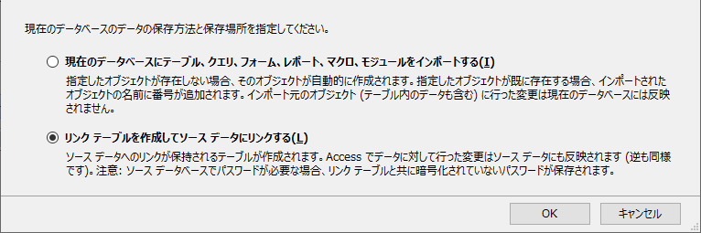
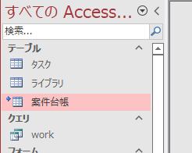
Linking Shared Tables
To make shared tables editable in ALAYA, they must be added to the menu module as linked tables. Launch the menu module in development mode. Embed the shared tables as linked tables.
Linked tables store absolute paths inside the GUI module. This means the module will always reference the same location regardless of where the GUI module file itself is stored.
If you use mapped network drives, all clients must use the same drive letter, which is error‑prone. Therefore, it is recommended to use UNC paths such as:
\\[ServerName]\[SharePath]\[DBModuleName].accdb

Slide 17
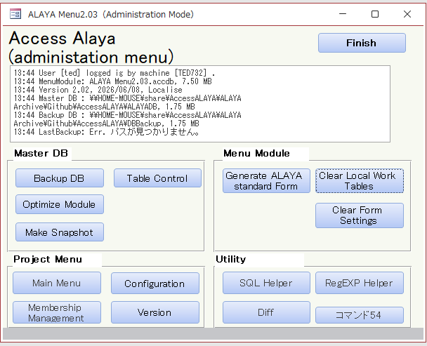
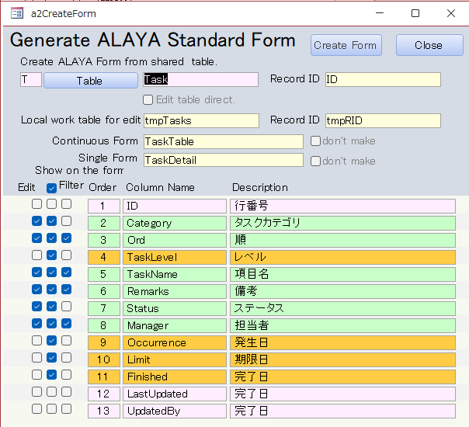
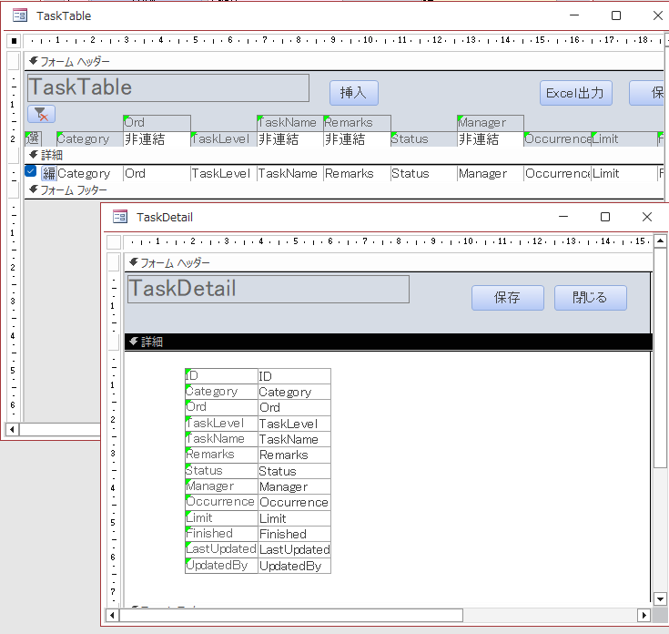
Creating ALAYA Forms
Standard forms can be generated from
the Administrator Menu → Generate Standard Form.
When executed, ALAYA automatically creates a Continuous Form and a Single Form with default controls and embedded code.

Slide 18
Configuration Items
Configuration Items.
1. Table
Specify the shared table name embedded as a link table.
The field list will be displayed automatically.
2. Local Table for Editing
Specify the local work table for editing.
3. Continuous Form
Specify the name of the Continuous Form to be generated.
4. Single Form
Specify the name of the Single Form to be generated.
5. Record ID
Specify the record identifier column for both the shared table and the local table.
CheckBox Options
Edit
Marks the field as editable.
Show
Include the field in the Continuous Form.
Filter
Adds a filter control for the field.

Slide 19
ALAYA Object Modules

Slide 20
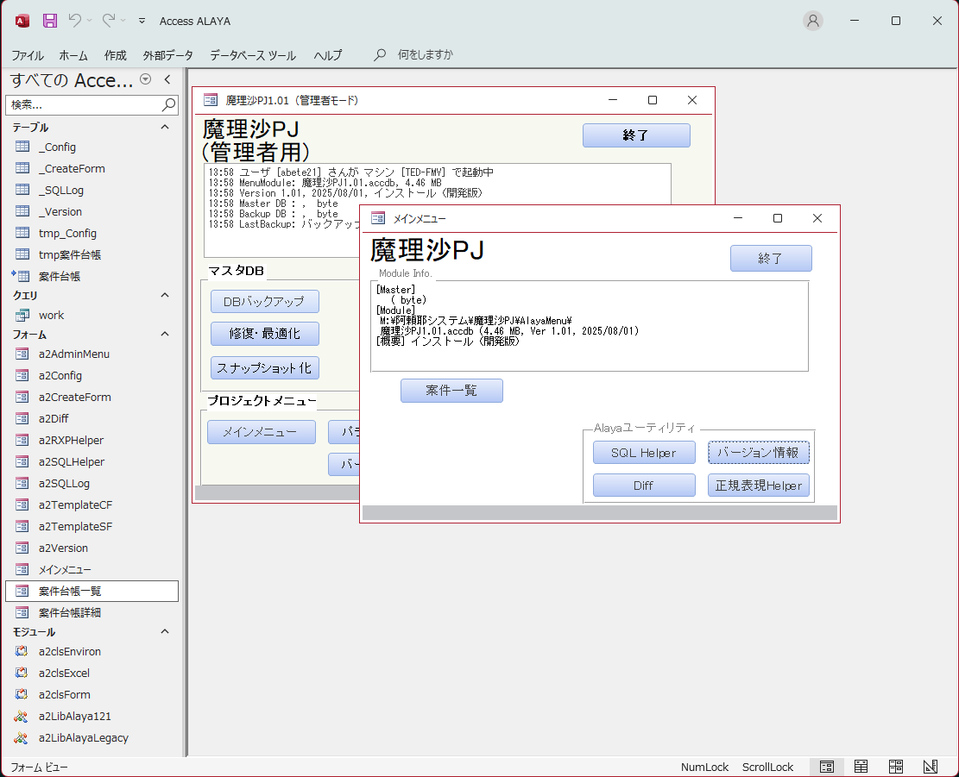
ALAYA Libraris
Alaya module includes Tables, Forms and Modules shown below.
種別 | Accessオブジェクト | 内容
Tables | _Calendar | Sequential date table from 1990/1/1~2049/12/31
 | _Config | Set of Configuration parameters.
 | _CreateForm | WorkTable for generate ALAYA standard forms.
 | _SQLLog | SQL history executed from the Alaya modules.
 | _Version | Version table.
 | tmp** | Local tables for editing.
Forms | a2AdminMenu | Administrator’s Menu. The default startup form.
 | a2Config | Edit form for Parameters.( _Config table)
 | a2RXPHelper | ALAYA tool. Regular expression Helper.
 | a2SQLHelper | ALAYA tool. Support tool for SQL edit and execution.
 | a2SQLLog | Viewer form for SQL Log.
 | a2TemplateCF/SF | Form template for generating the ALAYA standard form.
 | a2Version | Version info.
 | ALAYA Menu | Normal mode menu.
Modules | a2LibALAYA** | ALAYA function library.(** is the version number.)
 | a2clsEnviron | Environment control class module.
 | a2clsForm | Form control class module.
 | a2clsExcel | Excel control class module.
Naming Conventions and Startup Behavior in Access ALAYA
Access ALAYA uses a consistent naming convention to clearly distinguish ALAYA modules and functions from user‑defined modules. As a general rule:
Constants use the prefix a2_
Functions use the prefix a2 (without an underscore)
This makes it easy to identify ALAYA‑specific components within a project.
Startup Behavior
When ALAYA starts, the administrator menu (a2AdminMenu) is launched by default.
If ALAYA is started with arguments, or started while holding the Shift key,
then a2AdminMenu is displayed directly.
If ALAYA is started without any arguments, the system hides the Navigation Pane and displays the ALAYA Menu intended for general users. See the starting code of ‘Form_Load’ in a2AdminMenu.

Slide 21
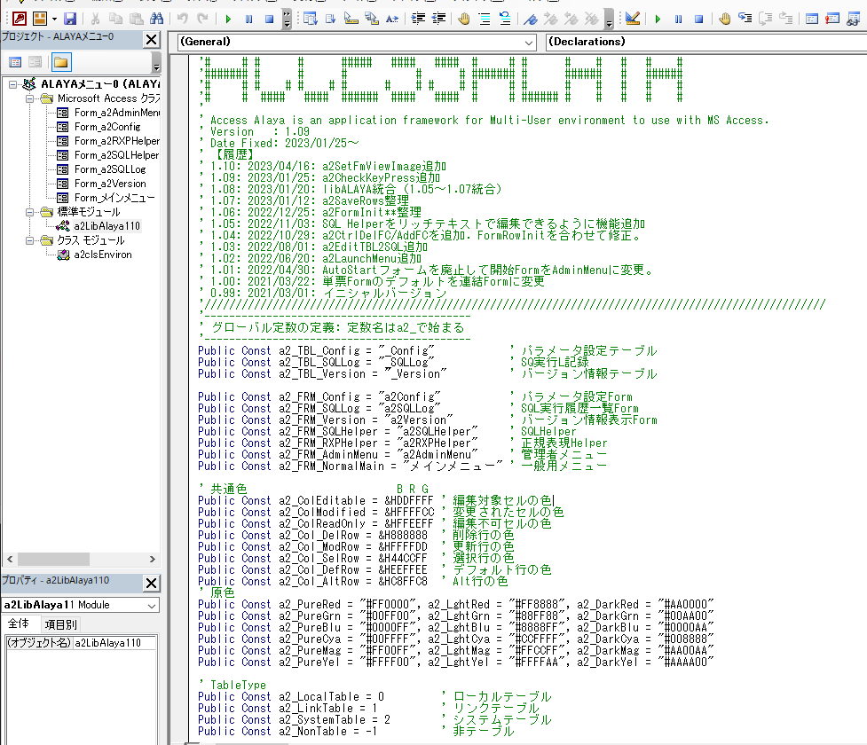
ALAYA Constant and Core Functions
The module a2LibALAYA defines all ALAYA constants and ALAYA functions. This section introduces the ALAYA constants and the primary functions commonly used for form initialization and other core operations.
ALAYA Constants
ALAYA Constants are global constants whose name begins with the prefix ‘a2_’. They define Items such as:
TableNames
FormNames
Background colors used in conditional formatting.
These constants provide a unified naming scheme and ensure consistency across all ALAYA modules.
Constant Name | Meaning
a2_TBL_** | Table Name.
a2_FRM_** | Form Name.
a2_Col_** | Color number used in conditional formatting and so on.
Table Type
a2_LinkTable a2_LocalTable a2_SystemTable a2_NonTable | The type is a Link Table The type is a Local Table. The type is a System Table. The type is Not table.
Form Type
a2_SingleForm a2_ContinuousForm a2_OtherForm | The form is a single form. The type is a continuous form. Other type of form. (sub form, complexed form, dialog form, etc.)
Edit mode to initialize a form.
a2_EditClone a2_EditLocal a2_EditShare a2_EditUnbound | Edit the Clone data from shared table to the local table.(Default mode) Edit the table as a local table. Open the shared table direct with read only mode.(Not recommended). Form is used as an unbound single form.

Slide 22
ALAYA Functions
ALAYA Functions begin with the prefix ‘a2’(without underscore).
These functions implement the core behavior of the ALAYA framework and are used throughout form initialization, data handling, and system operations.
Function | Meanings
Environment Setting functions.
a2Init a2Dbg TRON TROFF a2Progress : | Initialize ALAYA Environment include MyEnv(a2clsEnviron) object. Embed debug message in code. Trace On. This is Basic! Show the debug message embedded in the code. Trace Off. This is Basic, also! Show a status message on the Access status area and control hourglass on/Off. :
Environment setting class(a2clsEnviron)
The class module 'a2clsEnviron' is used for environment configuration during ALAYA execution.
It is instantiated as the global object ‘MyEnv’ and used for retrieving data from the a2_TBL_Config(_Config) table and passing variables between Forms.
a2clsEnviron
Feature | Set ALAYA Environment with ‘MyEnv’ Global Objec.
Class Variable | Description
UserName | Share table name on the file server.
ComputerName | Local table to edit. Share table data is loaded to this local table.
Class Method | Record identifier of the shared table. Comma delimited when the table uses a composite key.
Init | Initialize the ALAYA configurations. This method runs very light and will not cause overhead for applications, then run in ‘a2init’ command any time you debug the codes.
SetHash | Set Hash Table for exchanging parameters between forms. In Form A set ‘ MyEnv.SetHasf(“PARAM”)=“AA”, then Form B can get the PARAM as ‘ PARAM=MyEnv.GetParam(“PARAM”)’
GetHadh | Get the Hash Parameter set set by SetHash method.
GetConfig | Get parameter in ‘a2_TBL_Config’ table specified by ‘KeyName’. e.g. GetConfig=Dlookup(“KeyValu”, a2_TBL,Config’, “KeyName=‘ & Key & “’”) Any comment part, enclosed in /* */ and begins with ‘—’ , would be erased.
GetSQL | Get SQL Code registered into a2_TBL_Config table. The SQL written in ALAYA format, with comment and macros, will be converted as executable code erasing comments and expanding macros.

Slide 23
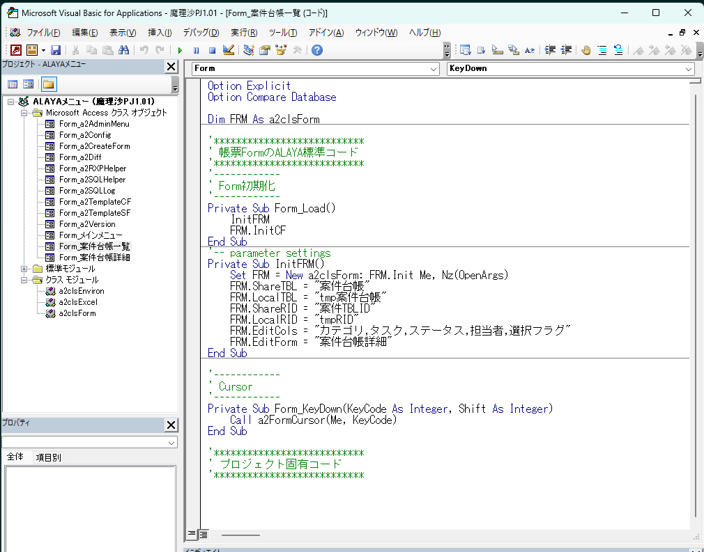
Form Control class module(a2clsForm)
The class module a2cldForm is used to initialize and control ALAYA standard forms.
By setting class variables and calling functions, you can set conditional formatting for controls or give functions to command buttons.
a2clsForm
Feature | Form Control class module. Initialize and control the ALAYA standard form with parameter and macro settings.
Class Variable | Description
ShareTBL | Share table name on the file server.
LocalTBL | Local table to edit. Share table data is loaded to this local table.
ShareRID | Record identifier of the shared table. Comma delimited when the table uses a composite key.
LocalRID | Record identifier of the shared table. Comma delimited when the table uses a composite key.
EditCols | Edit columns separated by comma. Specified columns will be editable in light yellow background color.
RgstCols | Registering columns except edit columns, such as system generated data, time stamp, serial number, etc.. The updating columns will be EditCols + RgstCols.
EditForm | Single form name to edit when the initializing form is a continuous form.
FormType | The type of Continuous Form（a2_ContinuousForm）or Single Form（a2_SingleForm）.
EditMode | Form Edit mode. Default mode is a2_EditClone (clone data from shared table to local).
DictArgs | Dictionary object converted from OpenArgs that brought from DoCmd.Open. When Openargs is set as ‘Col1=aa, Col2=bb, Col3=cc’ , DictArgs would be as ‘DictArgs(“Col1”) = aa, DictArgs(“Col2”)=bb, DictArgs(“Col3”)=cc’

Slide 24
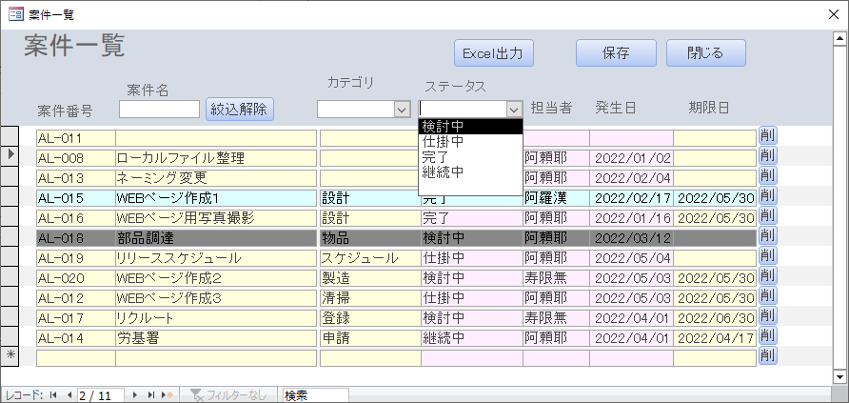
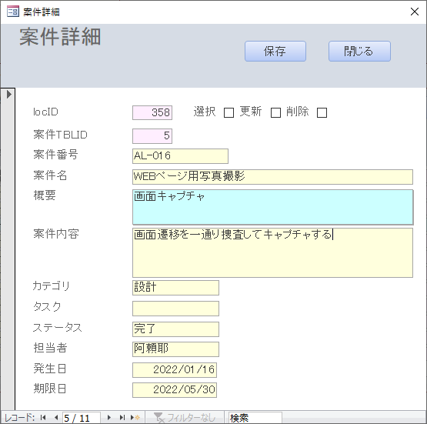
a2clsForm(continue)
Methos | Description
Init | Initialize Form object. Substitute of a constructor.
InitCF | Initialise the form as a Continuous Form. The following functions will be added on the form. Load data into the editing table Color coding and conditional formatting for editable/non-editable cells Standard button control settings (Excel output, save, clear filter, close) Filter control settings Image control settings (double-click to open the default viewer) Edit command button settings (insert row, copy row, edit row, delete row)
ShowModRows | Filter to show only edited wors for verification to be saved.
InitSF | Initialize the form as a single form.The following functions will be added. Color coding and conditional formatting for editable/non-editable cells Transfer the values ​​set in the OpenArgs arguments to the unbound control. Image control settings (double-click to open the default viewer) Standard button control settings (Excel output, save, clear filter, close) Image control settings (double-click to open the default viewer)
OrderBy | Sort of the From.Recordsource
SetLoadSQL | Set the Record Source SQL to load to the local table that start with ‘Select’(Not ‘Insert into’). Default source is the shared table it self, but if the source contains 2 or more tables, it should be specified as a SQL on this parameter.
Load2LocalTBL | Load the shared table data to the local table.
SaveRows | Save the modified rows to the shared table. (See the ALAYA Function ‘a2EditSaveRows’.)
Standard Buttons
Filtering
Color codig and conditional formatting
Standard Buttons
Color condings

Slide 25
Record Savings
FRM.SaveRows method
Function | Save the EDIT ROWS to the shared table.
Syntax | a2SetCmdSaveRows(CMD, FormName, ShareTBL, LocalTBL, IDColumn, RgstCols)
Return | 更新、削除行数を示す実行結果のログ文字列
Parameters
TargetSaveTBL | Target shared table to save. If omitted, FRM,SahreTBL is used.
TargetRecordID | Shared table ID column name for ‘update join on’ If omitted,FRM.ShareRID is used.
LocalTargetID | Local Table ID column name. for ‘update Join on’. If omitted, FRM.LocalRID is used.
Wcond | Where condition to filter target update record. Blank If omitted.
【Explanation】
By default, edits made in LocalTBL are reflected and saved in ShareTBL. However, if the format of LocalTBL differs from that of ShareTBL, or if you want to save to multiple tables, you will need to write your own save event code. In this case, using the FRM.SaveRows method makes it relatively easy to write the code.
For details, please refer to the ALAYA function a2EditSaveRows → a2EditTBL2SQL code.
a2EditTBL2SQL
Function | Get SQL code to update the shared table from the local Edit table.
Syntax | a2EditTBL2Server(ShareTBL, LocalTBL, UpdateCols, SCol, LCol, WhrCond)
Return | Executable SQL update statement.
Parameters
UpdateTBL (String) | Target table to update.
EditTBL (String) | Local edit table.
UpdateCols (String) | List of update columns delimited by comma.
LeftKeys (String) | Join On columns. (update table side) .
RightKeys (String) | Join On columns. (Edit table side) . If omitted, the same columns is used as leftkeys.
WhrCond (String) | Where condition to filter target update record. If omitted, it will be blank.
[Explanation]
The default saving function a2MacroSaveRows can only update one table at a time. If you want to update multiple tables simultaneously during saving, you need to write code to update each table individually in the save button's event handler.
Please refer to a2MacroSaveRows for how to write the code.
Share
A
Share
B
Share
A
Share
B
Edit
TBL
Edit
TBL
Default action.
Save one table at a time.
If you want to update multiple tables, you need to write code in the evend handler.
Share
A
Share
A
Share
B

Slide 26
Updating SQL
[Explanation]
The following VBA code and SQL are sample SQL obtained using the a2EditTBL2SQL function.. Using Update Right Join, it performs both updating and inserting only the changed records in a single Update operation.
VBA
'*************
' Sample VBA
'*************
Public Function testsql()
Dim SQL As String
Dim ShareTBL As String, LocalTBL As String, EditCols As String, ShareRID As String
ShareTBL = "Task"
LocalTBL = "tmpTask"
EditCols = "Category,Order,TaskLevel,Remarks,Status,Managet,Limit,Finished"
ShareRID = "ID"
SQL = a2EditTBL2SQL(ShareTBL, LocalTBL, EditCols, ShareRID)
Debug.Print SQL
End Function
SQL
Update Task as L Right Join tmpTask as R
On L.[ID] = R.[ID]
Set L.[Category] = R.[Category]
, L.[Ord] = R.[Ord]
, L.[TaskLevel] = R.[TaskLevel]
, L.[TaskName] = R.[TaskName]
, L.[Remarks] = R.[Remarks]
, L.[Status] = R.[Status]
, L.[Manager] = R.[Manager]
, L.[Limit] = R.[Limit]
, L.[Finished] = R.[Finished]
, L.[LastUpdated] = #2026/06/13 13:35:37#
, L.[UpdatedBy] = 'ted'
Where R.[isUpdated] = True AND R.[isDeleted] = False

Slide 27
Let's enjoy the world of Access ALAYA together!
© 2022 abete21
https://accessalaya.jp
AccessALAYA@gmail.com

